Slide 1
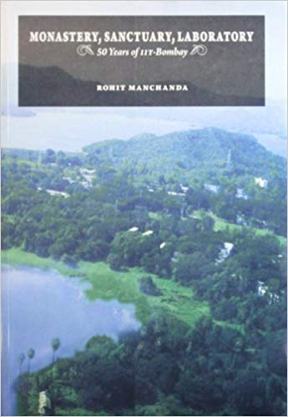
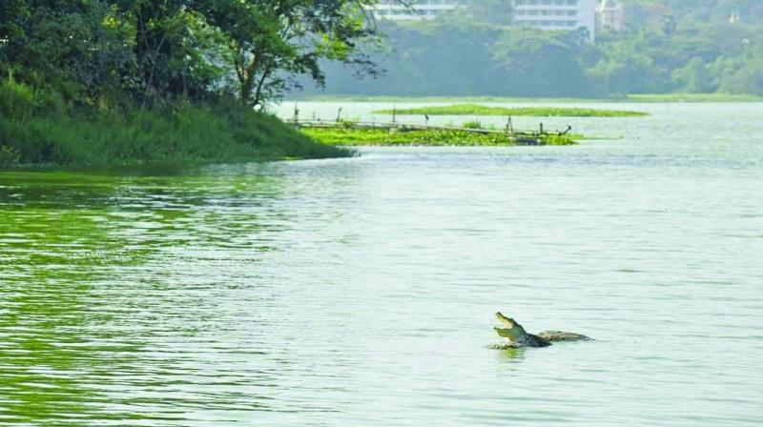
HS 200: Environmental Studies (Autumn 2020)
D.Parthasarathy (Sociology)
Department of Humanities and Social Sciences
Inter-Disciplinary Program in Climate Studies
Co-Instructors:
Prof.Aditi Chaubal (Economics) and Prof.Rajakishore Nath (Philosophy)

Slide 2
Module: Social Issues and the Environment
Governance
Laws and regulations
Access
Equity
Conflicts

Slide 3
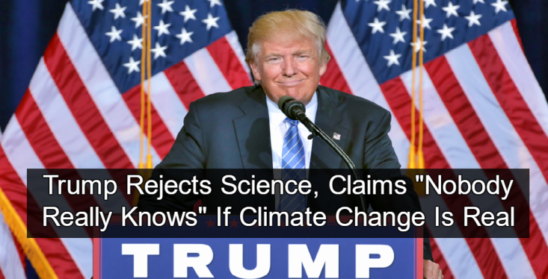
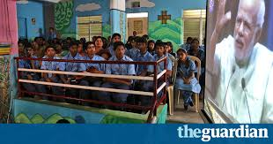
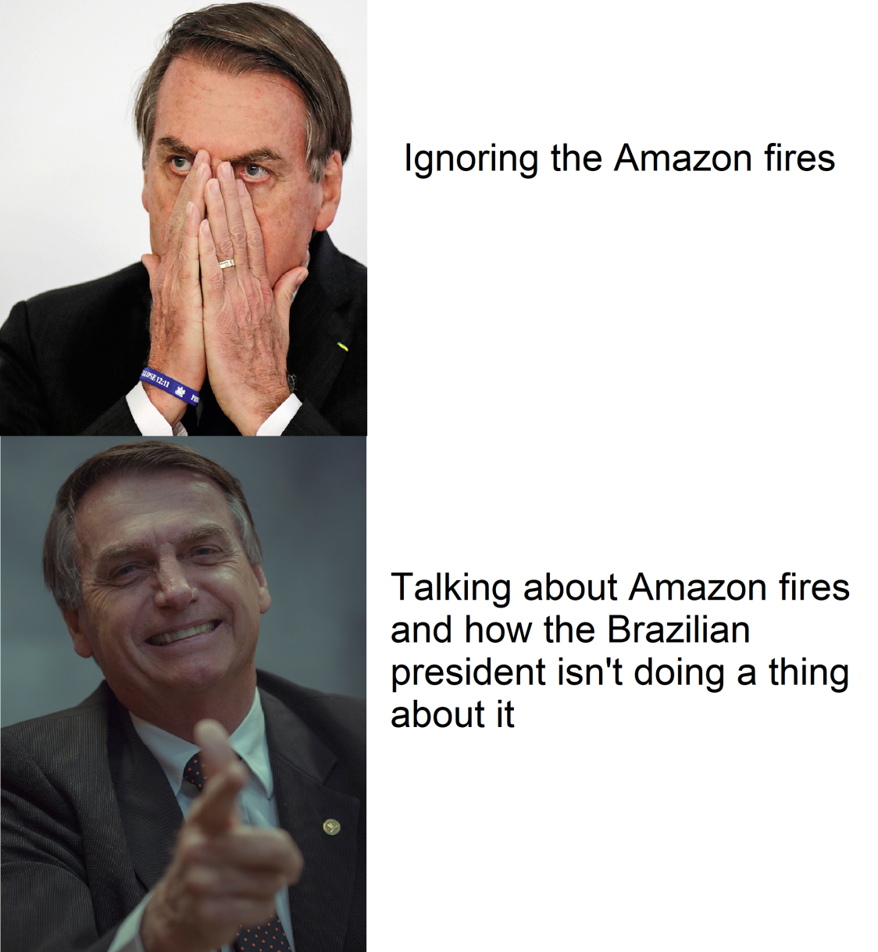
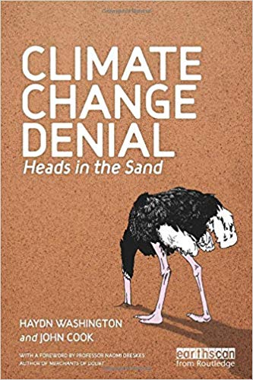
The Human costs of environmental degradation and inaction
Stupidity? Ignorance? Arrogance? Selfishness? Shortsighted? Uncaring?
Is Narendra Modi a climate sceptic?
India’s PM used to call climate action a moral duty, now he tells students ‘climate has not changed, we have changed’ (from Guardian newspaper)

Slide 4
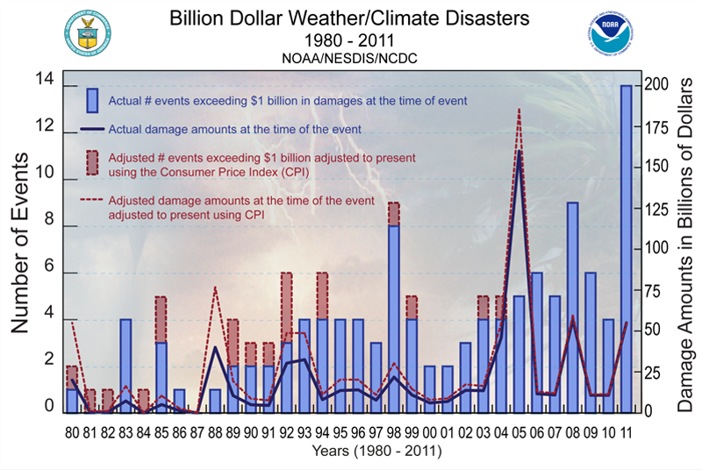
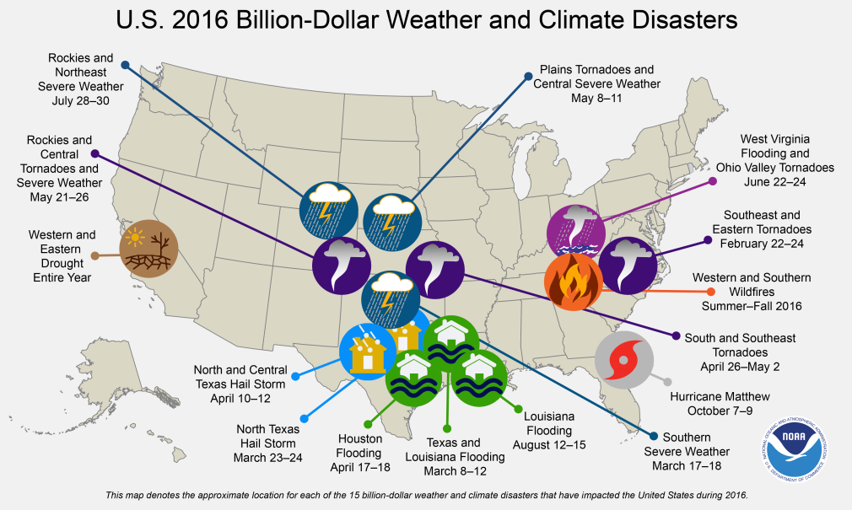
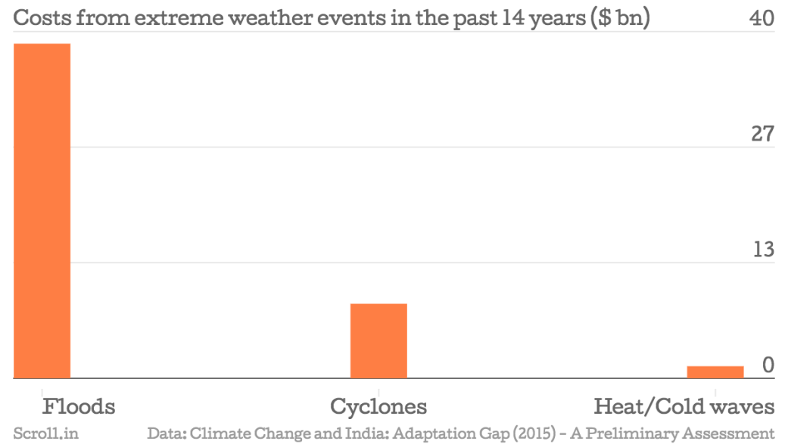
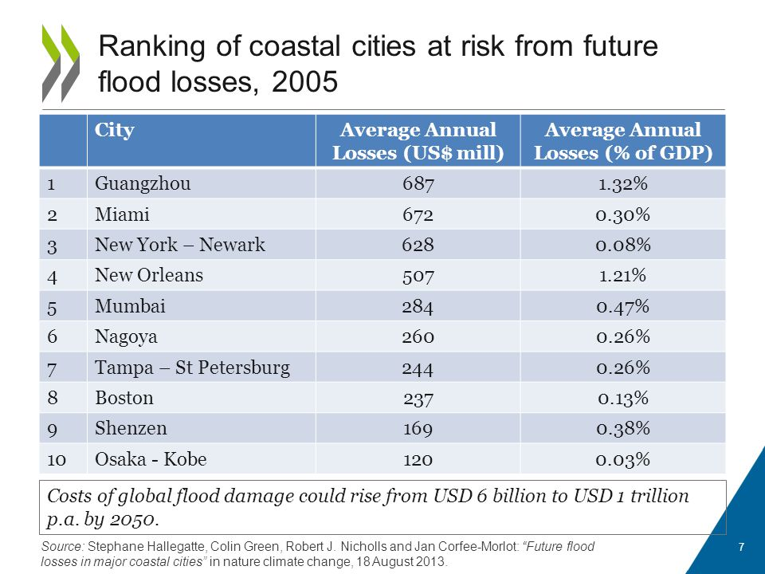
India may need a whopping $1 trillion by 2030 to adapt to climate change, says new report

Slide 5
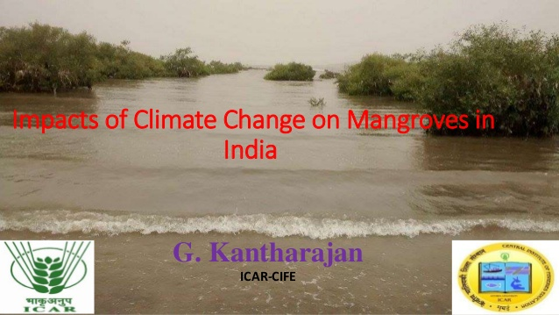
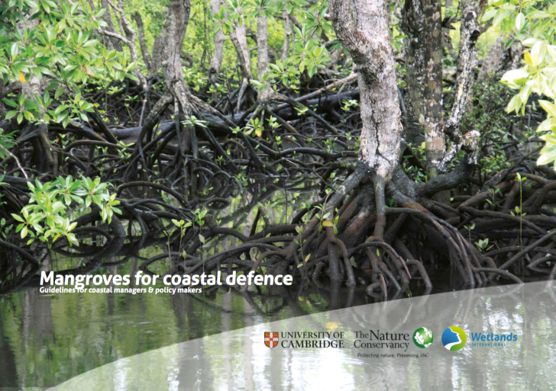
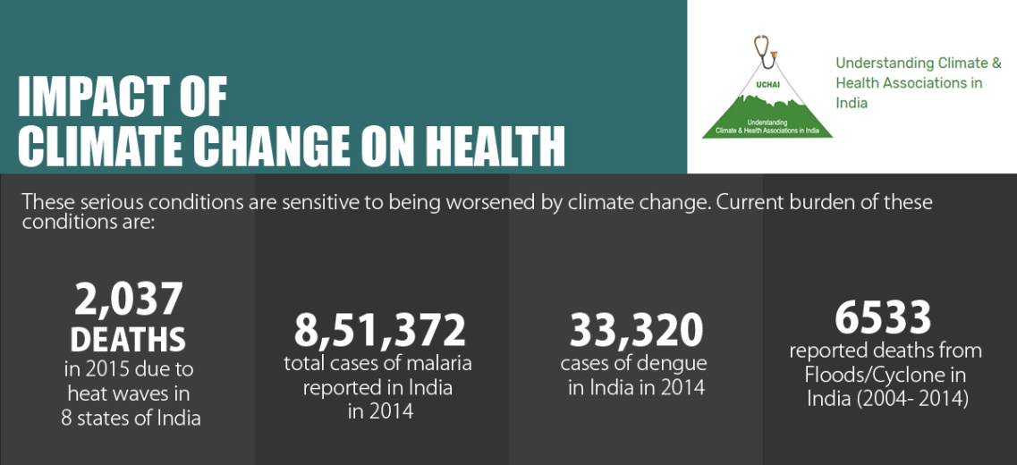
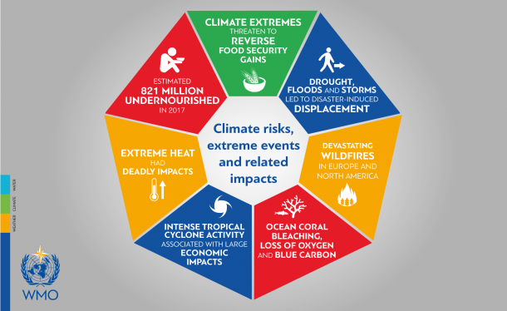
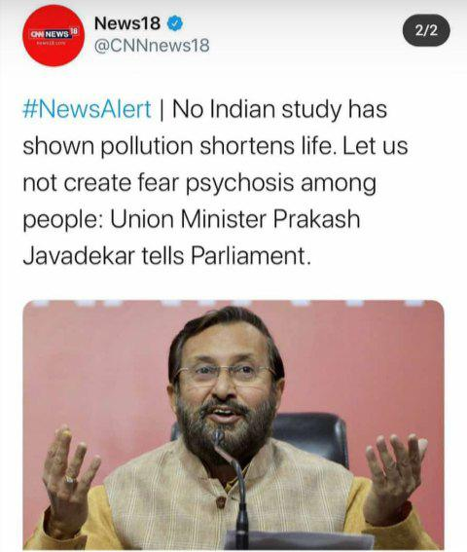

Slide 6
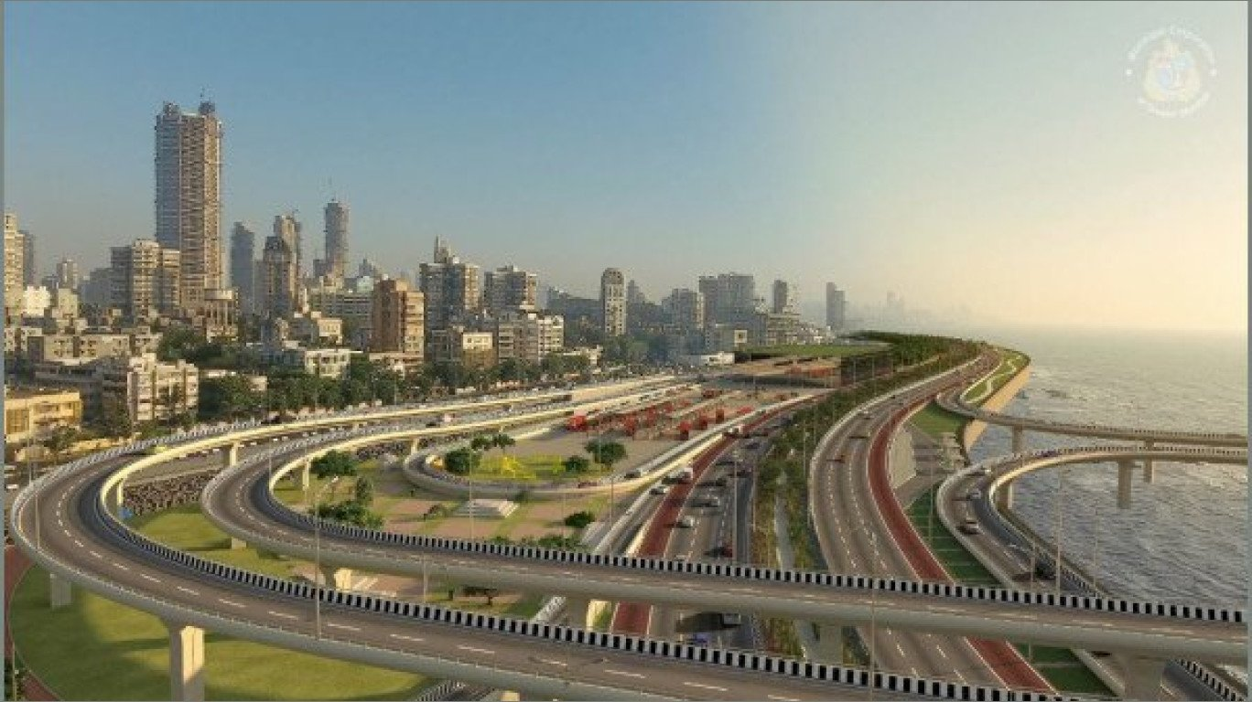
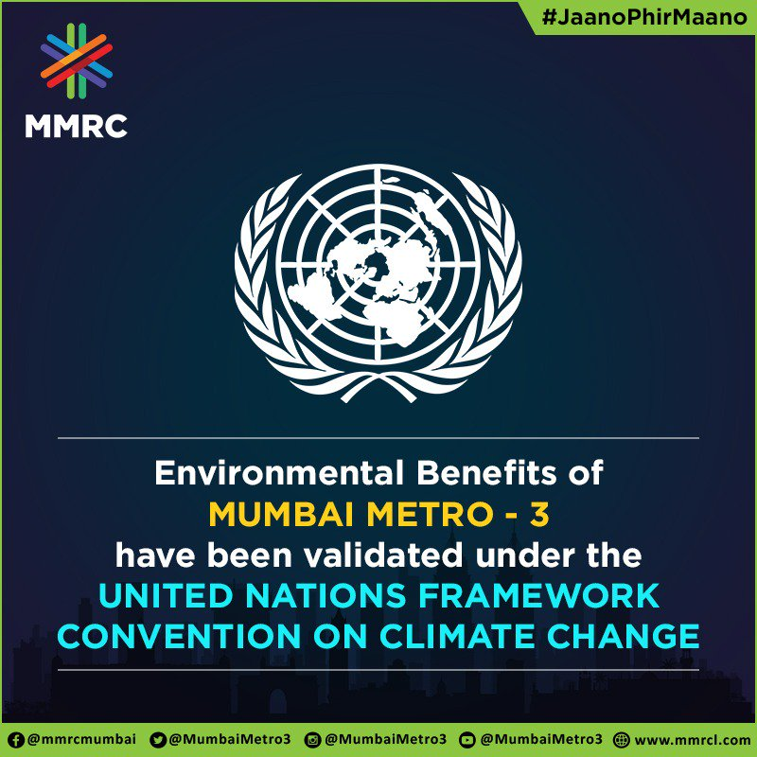
Coastal Road Will Enhance The Environment Further: BMC Chief Praveen Pardeshi
What is loss to environment? Metro will stop 10,000 metric tonnes of emissions, says Mumbai Metro Rail Director

Slide 7
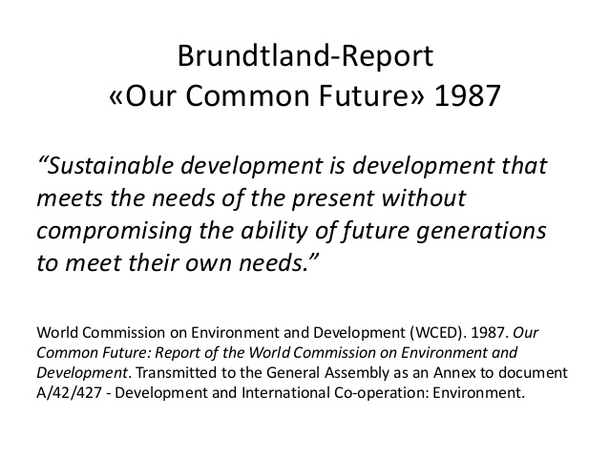
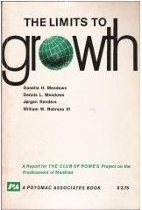

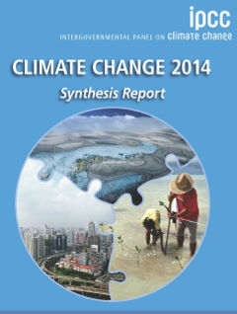
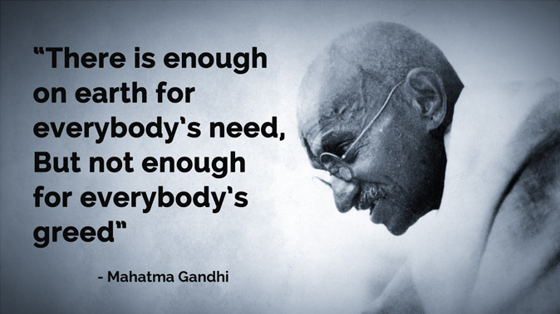
Development, Economic Growth and Environment: Facts, Myths, Evidence, Lies, Ignorance
Judges, Bureaucrats and Politicians: Balance? Both? How? Which choices? What technologies? What policies?

Slide 8
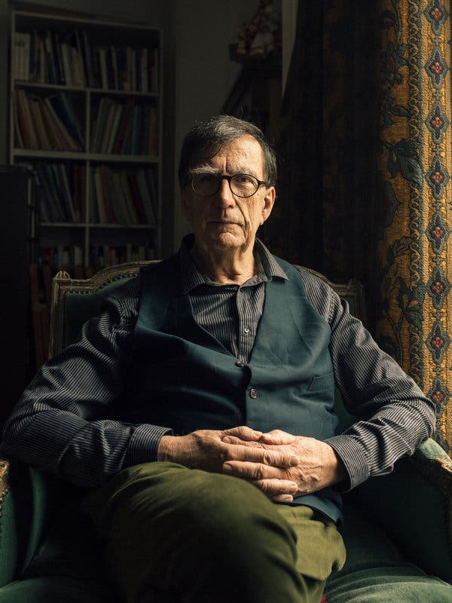
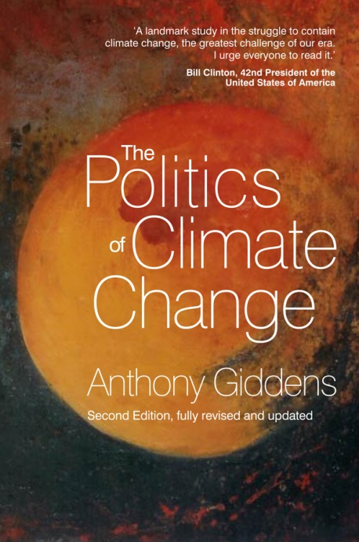
Human Unreason
Bruno Latour: “facts remain robust only when they are supported by a common culture, by institutions that can be trusted, by a more or less decent public life, by more or less reliable media.”
Giddens’ Paradox

Slide 9
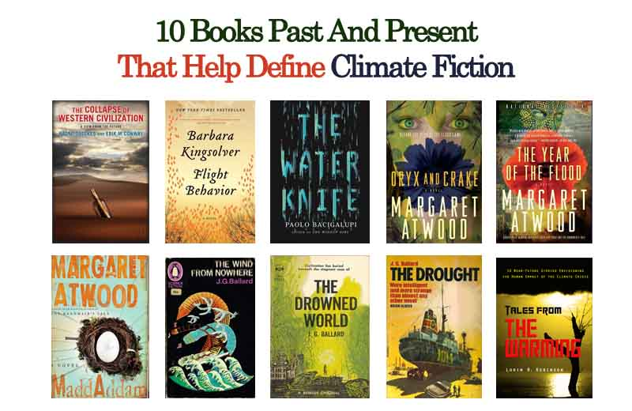
How can the social sciences and humanities help us to better understand environmental issues?

Slide 10
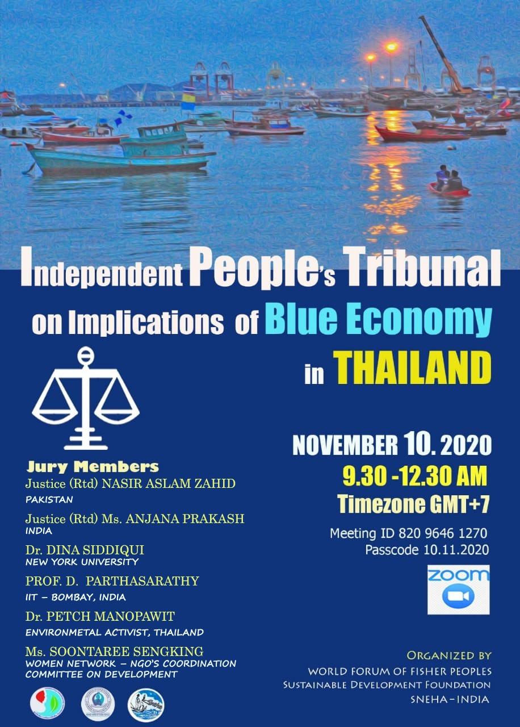
Indian Time: 8.00 to 11.30 AM
Organisations working on the issues of fishworkers, coastal communities and environment especially in South and South East Asia have initiated an effort to explore the grassroots knowledge production that the established dominant discourse on Blue Economy professes.
The initiative is to understand the socio-economic political ecological implications of Blue Economy on coastal communities especially with respect to Small Scale Fisheries Sector, Fishworkers and Women.
Bangladesh, Pakistan, India, Thailand, Sri Lanka, Indonesia are the countries who are involved in this process and an extensive research looking at the stage of Blue Economy/ Blue Growth both at the policy level and at the grassroots is being undertaken.

